Slide 1

Global Mental Health in a Christian Context

Slide 2
God’s Power in Weakness

Slide 3
Overview
1. The attitude of Jesus (Philippians 2:5-7)
2. The human factor ("human likeness", V.7)
3. What can we learn in weakness (Hebrews 2:17-18)
4. Power out of weakness (2 Cor 1:8-10, 3-4)

Slide 4
1. The attitude of Jesus
  (Philippians 2:5-7)
Jesus loves everyone the same - he loves you as you are.
For Jesus the weak have the same value as the strong.
Jesus came to serve.

Slide 5
2. The human factor
Jesus took on human likeness (V. 7)
What does it mean that he took our human likeness?
  he had unfulfilled needs
  he had times of exhaustion
  he felt pain
  he had times of temptation
  he had times of darkness
The consequence: He understands us in our weakness

Slide 6
3. What can we learn in weakness?
Hebrews 2:17-18
2 Cor 1:8-10, 3-4
The experience of weakness
  can make us merciful with those who are weak.
  can help us see the beauty of those who are not able to display any external power …
  see the inner beauty of a person even in mental distress and illness, but also in mental and physical handicap

Slide 7
4. Power out of weakness
  Isaiah 43:2-4
inner strength in trusting God
experiencing the presence of Jesus in the midst of roaring rivers
What are the rivers that threaten to drown you today?
What are the fires that you have to go through?
He gives you his love and his value

Slide 8
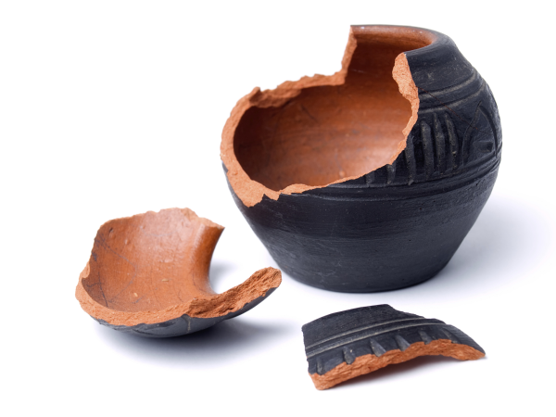
Support the Weak
Biblical emphasis of WEAKNESS
2. Corinthians 12:11
2. Corinthians 4:6-10
Isaiah 42:1-4: bruised reed, smoldering wick

Slide 9
www.psy77.com
Download

